Slide 1
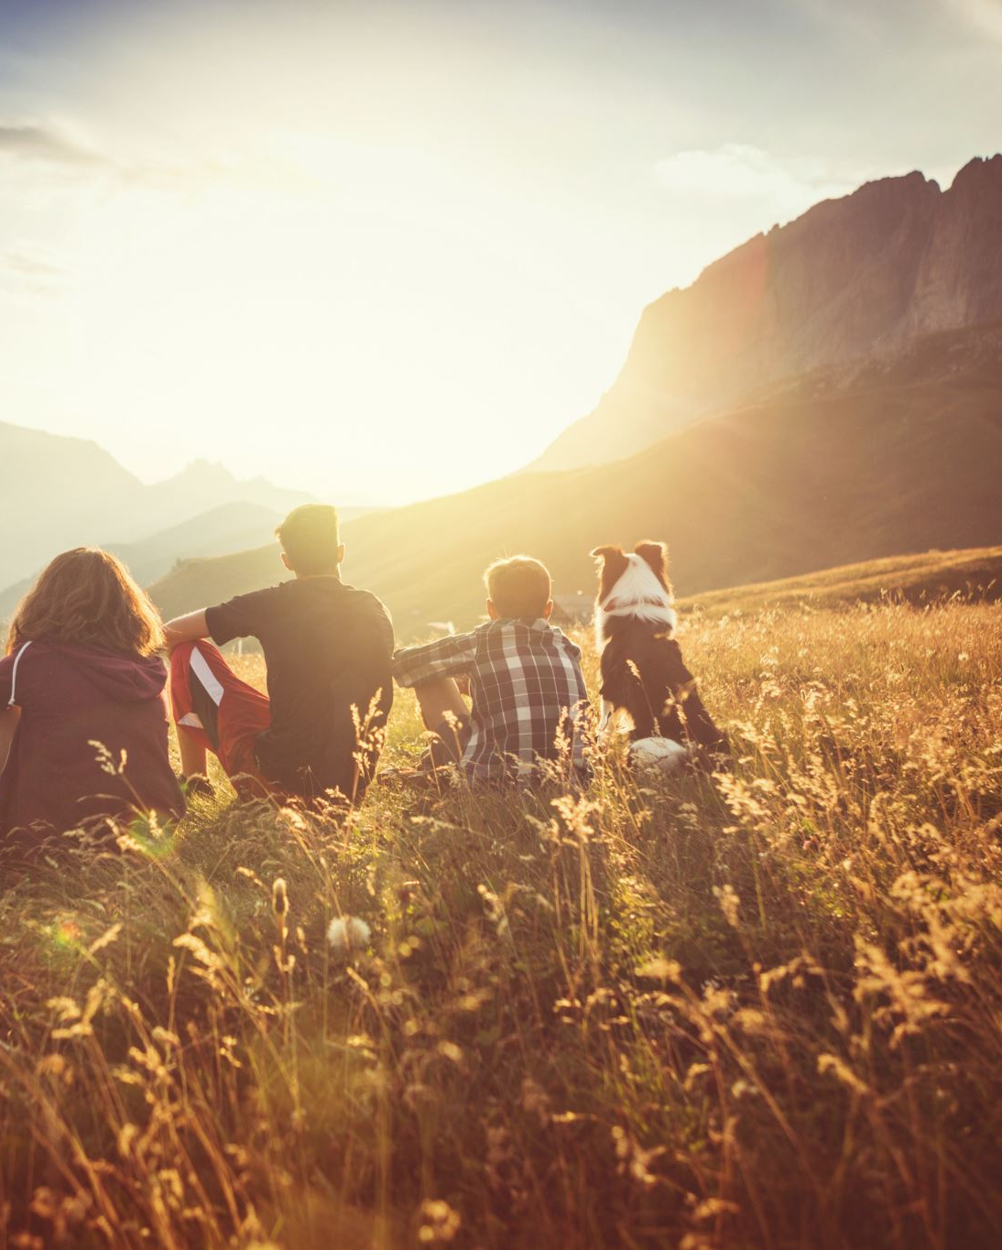
Image Colorization
Submitted By:
Uttara Dabbiru (py4642)
Priyanka Shah (mt8964)
Under the guidance of:
Dr. Surendra Sarnikar

Slide 2
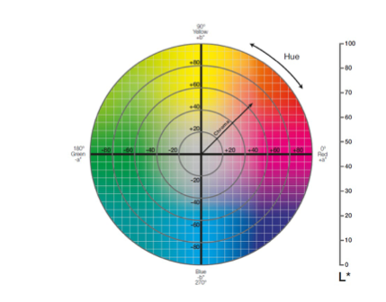
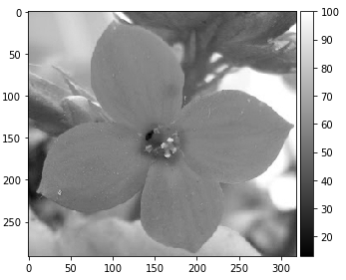
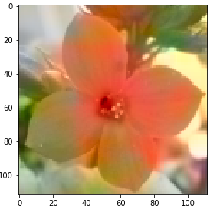
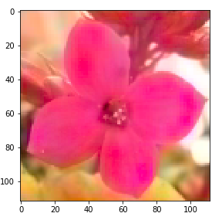
Autoencoders
Encoder: transforms the input data into a lower-dimensional representation. To achieve this goal, the encoder must learn only the important features of the data.
Decoder: recovers the input from the low-dimensional representation.
CIELAB RGB to LAB LAB to RGB LAB to RGB(BN)

Slide 3
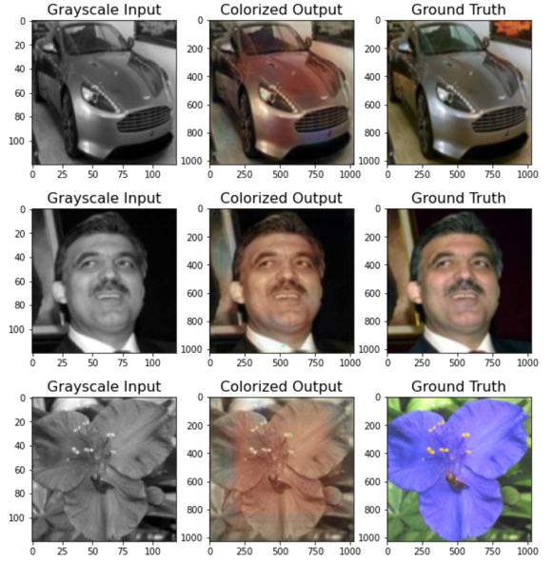
Pix2Pix GAN
Generator: It turns noise into an imitation of data to try to trick discriminator.
Discriminator: It tries to identify real and fake data.
The images obtained from the GAN model are shown here

Slide 4
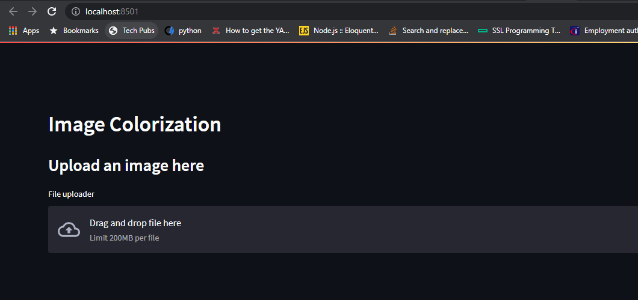
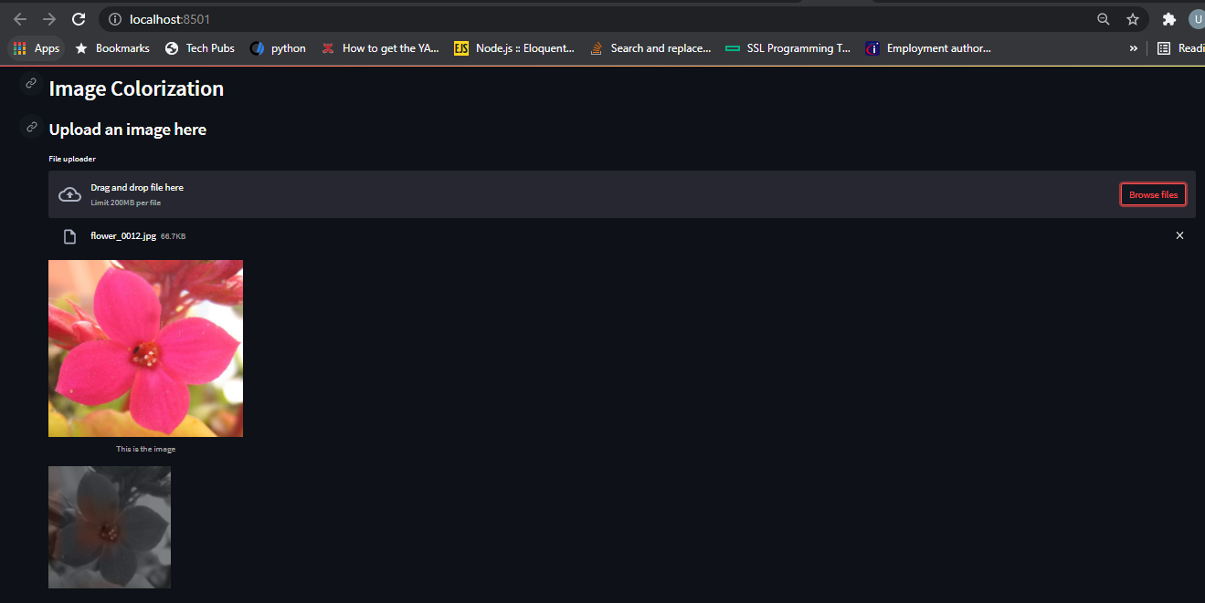
Web Application using Streamlit
The Image is reshaped
The image is converted from RGB to Greyscale
Traces of color can be noticed on the output image

Slide 5
Conclusion and Discussion
Color is the primary factor responsible for making a photo feel exciting, lively, mysterious or perhaps melancholic. Coloring an image can help tell us story visually and it can be used to communicate on an emotional level.
By using this project, we can convert old B/W photos of grandparents into colorized photo making that more memorable.
We can extend this project by colorizing the videos too as well as include various filters unlike greyscale.

